Slide 1
Hybrid NOMA Offloading in Multi-User MEC Networks
By: Imroatul Faiseh – M103620002

Slide 2
Advantage Of MEC Networks
Hastening Data Transmission
Transmission data from base stasion with MEC server and user is hastening than not using MEC
Reducing Network Load
Reducing to use bigger bandwith and load. because of the algorithm used in the mec, the bandwidth and load usage will decrease, even so the data transmission speed is still better
Scalable Performance
Increase performance by adding additional ressources. Example: If we need to serve more users, we just add additional server”
Source Journal: Impact of Non-orthogonal Multiple Access on the Offloading of Mobile Edge Computing

Slide 3
Advantage Of Hybrid NOMA
Massive Connectivity
Connecting a large number of smartphone to the base stasion
Lower latency refers to a minimal delay in the processing of smartphone data over a network connection. The lower the processing latency, the closer it approaches real-time access.
Lowers Latency
[2]
Multiple users are served simultaneously in a single resource block. if usually the base station will provide the best signal to the smartphone with good signal strength in the shortest time, then with hybrid noma, it will send data transmission with a flexible timeframe
Improve User Fairness
Spectral Efficiency
Spectral efficiency is a measure of the performance of channel coding methods. It refers to the ability of a given channel encoding method to utilize bandwidth efficiently. It is defined as the average number of bits per unit of time (bit rate) that can be transmitted per unit of bandwidth (bits per second per Hertz) will be better than not using hybrid NOMA.
Increases Reliability
Multiple users, start and end are made flexible.
Source Journal: Impact of Non-orthogonal Multiple Access on the Offloading of Mobile Edge Computing
Massive Connectivity in 5G and Beyond: Technical Enablers for the Energy and Automotive Verticals

Slide 4
Objective
Development
A general multi-user hybrid NOMA-MEC offloading strategy is first developed, for which the two-user hybrid offloading strategy.
Optimization
To minimize the users’ energy consumption for MEC offloading while meeting delay and transmit power constraints
Analyzed
This paper use Pareto Optimality to analyze and the result is the proposed successive optimization algorithm realizes one of the Pareto optimal solutions for the considered multi-objective optimization problem, and the provided simulation results confirm the Pareto-optimality of the obtained solution

Slide 5
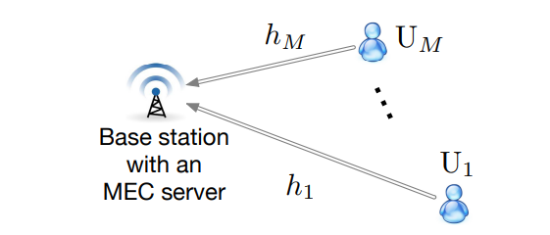
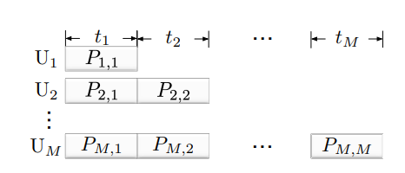
Hybrid Noma-MEC Offloading Strategy
Strategy
System Diagram
In particular, during the first t1 seconds, U1 is asked to complete its offloading, because its deadline is the most demanding one. In addition to U1, the other users are also allowed to carry out offloading during the first t1 seconds. During the next t2 seconds, U2 is asked to complete its offloading, where the other users, Um, 2 ≤ m ≤ M, can continue offloading their tasks simultaneously. This offloading strategy continues in a successive manner according to the users’ delay requirements, as shown in Fig. 1(b). During the last tM seconds, only UM is served, because all other users should have already completed their offloading by then. Denote the users’ transmit powers during tn by Pm,n, 1 ≤ n ≤ m, 1 ≤ m ≤ M

Slide 6

System Model
We note that both pure OMA and pure NOMA offloading are special cases of this hybrid NOMA offloading scheme. For example, by setting tm = 0 for m ≥ 2 (or Pm,n = 0 for n ≥ 2 and m ≥ 2), all users need to complete their offloading within the first t1 seconds, which corresponds to a pure NOMA scheme. If Pm,n = 0 for n < m, i.e., only a single user is allowed to transmit at a time, the hybrid NOMA scheme is degraded to the pure OMA scheme

Slide 7
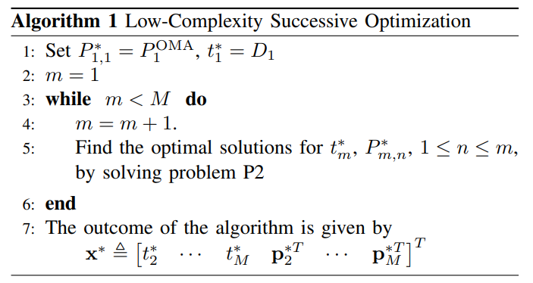
ALLOCATION ALGORITHM

Slide 8
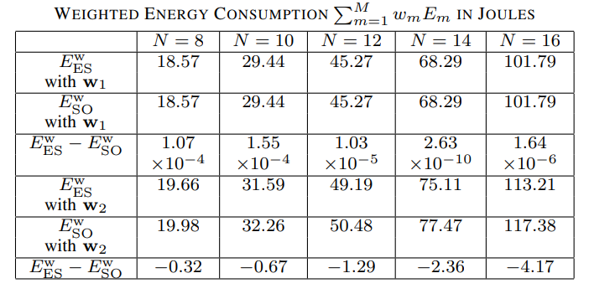
NUMERICAL STUDIES
Optimality of the Proposed Successive Optimization Algorithm
Let w with value that we assume will give the best result. From the table, we know that Weighted energy consumption is bigger when N is higher.
The minimum energy consumption predicted by Corollary 2 matches perfectly the exhaustive search result, which verifies the accuracy of Corollary 2

Slide 9
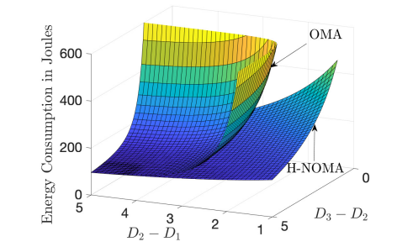
NUMERICAL STUDIES
Optimality of the Proposed Successive Optimization Algorithm
The use of hybrid NOMA-MEC can result in a significant reduction in energy consumption, compared to OMA-MEC
Impact of the users’ task deadlines on the energy consumed by MEC offloading with M = 3. D1 = 5, and N = 10. H-NOMA refers to the proposed hybrid NOMA scheme.

Slide 10
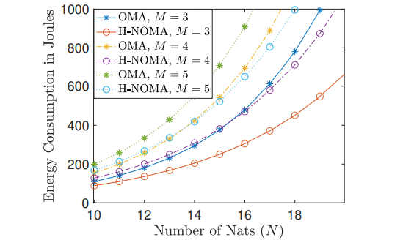
NUMERICAL STUDIES
Optimality of the Proposed Successive Optimization Algorithm
With continuous variables, the exhaustive search based scheme can only approximate the optimal solution. In other words, increasing the resolution of an exhaustive search reduces the gap between the outcome of the search and the optimal performance, but this gap cannot go to zero
Impact of the size of the tasks on the energy consumed by MEC offloading. D1 = 8, and Dm − Dm−1 = D1 2 .
Shows that the performance gain of NOMA-MEC over OMA-MEC is significantly larger for larger N, i.e., when the users’ tasks are large, it is more beneficial to use hybrid NOMA-MEC

Slide 11
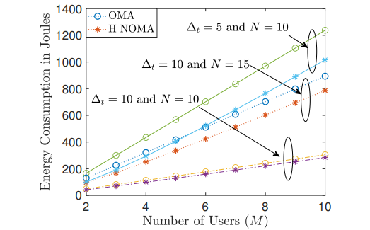
NUMERICAL STUDIES
Performance of the Proposed Successive Optimization Algorithm
The performance of MEC offloading is shown as a function of the number of users. In particular, the figure shows that increasing the number of users increases the overall energy consumption for both hybrid NOMA-MEC and OMA-MEC
Impact of the number of users on the energy consumed by MEC offloading. D1 = ∆t, and Dm − Dm−1 = ∆t 2

Slide 12
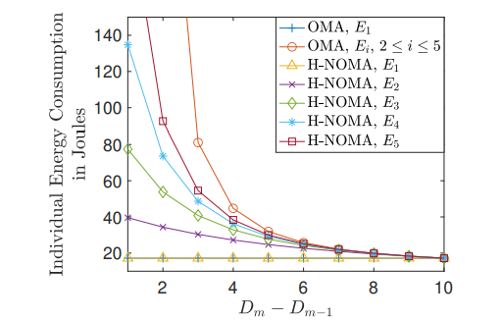
NUMERICAL STUDIES
Performance of the Proposed Successive Optimization Algorithm
Recall that there are two possible optimal solutions for problem P2, one based on hybrid NOMA and one based on pure OMA
Illustration of the condition under which hybrid NOMA-MEC and OMA-MEC achieve the same performance. M = 5, N = 10, and D1 = 5. The differences between Dm−1 and Dm are identical for 2 ≤ m ≤ M

Slide 13
Conclusions
Future Research
Investigate how to exploit hybrid SIC for further improving the performance of NOMA-MEC offloading
Hybrid NOMA-MEC Strategy
A general hybrid NOMA-MEC offloading strategy has been proposed. Hybrid NOMA better than OMA & Pure NOMA to reduce energy spectral consumption.
Important Insights
it is proved that pure NOMA-MEC offloading cannot outperform hybrid NOMA-MEC
Multi-Objective Optimization
Multi-objective optimization problem has been formulated for minimization of the users’ energy consumption for MEC offloading, where a lowcomplexity Pareto-optimal resource allocation solution has been obtained

Slide 14
Thank You ☺

